Slide 1

Version Date: 9Oct2020
Anger Care Pathway
Prevention Options
Prevention
Encourage patient to share their feelings and concerns
Prevention
Assessment
Assess routinely using SSPedi
Assessment
Mild Bother
(SSPedi score =
a little)
Moderate Bother
(SSPedi score =
medium)
Severe Bother
(SSPedi score =
a lot or extremely)
Allocate resources based on severity of bother and according to the preferences and capabilities of the patient
Treatment and Resources
Consult psychiatry, psychology, social work, art therapy, chaplaincy, child life services, music therapy or recreational therapy
Encourage peer support groups
Treatment
Consult psychosocial resource, particularly for violent thoughts towards self and others

Slide 2
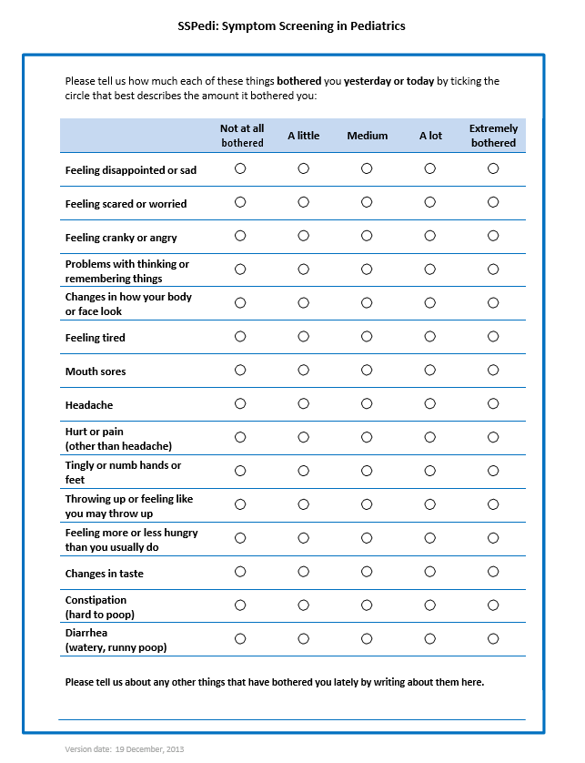

Version Date: 9OCt2020
Care Pathway

